Slide 1
Digital Electronics Project
Displaying A, W, S, D on 7-Segment Display using 74LS145

Slide 2
Project Overview
• This project displays the keys A, W, S, D on a 7-segment display.
• It is implemented using digital logic ICs without any microcontroller.
• The main ICs used are 74LS145, 74LS157, and 74LS47.

Slide 3
Components Used
• 74LS145 - BCD to Decimal Decoder
• 74LS157 - Multiplexer
• 74LS47 - BCD to 7-Segment Decoder
• 7-Segment Display (Common Cathode)
• Push Buttons, Resistors, and Transistors

Slide 4
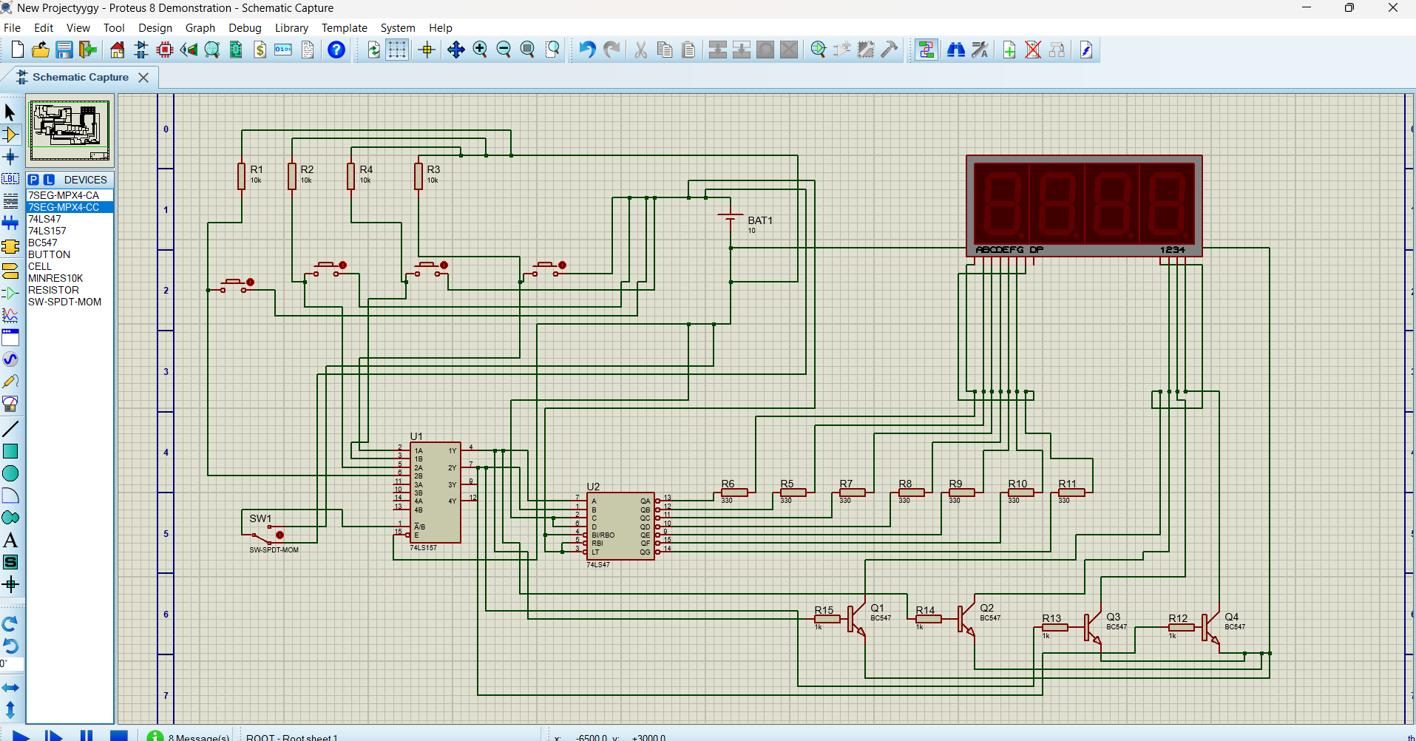
Circuit Diagram

Slide 5
Connection Table
• DIP Switches → 74LS145 Inputs (A, B, C, D)
• 74LS145 Outputs → 74LS157 Multiplexer Inputs
• 74LS157 Output → 74LS47 BCD to 7-Segment Decoder
• 74LS47 Output → 7-Segment Display
• Transistors control digit selection

Slide 6
Working Principle
• The DIP switches select binary inputs.
• 74LS145 decodes these inputs into decimal form.
• 74LS157 selects the required signals for 74LS47.
• 74LS47 converts BCD into segment control signals.
• The display shows the corresponding character.

Slide 7
Conclusion
• Successfully displayed A, W, S, D without a microcontroller.
• Used basic digital logic ICs to achieve the design.
• The project can be extended to show more characters or numbers.

